Slide 1
LESSON TWELVE
TOPICS: CREATING AND UPDATING 3D TEXT, DISPLAYING THE GAME TIME.

Slide 2
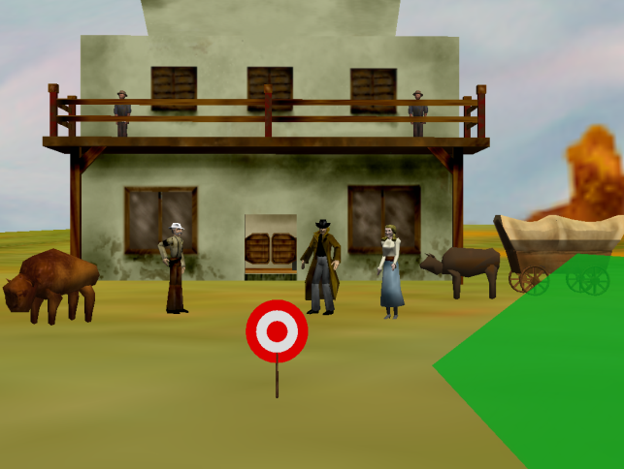
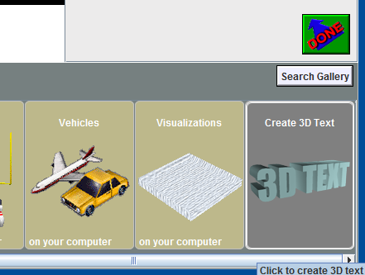
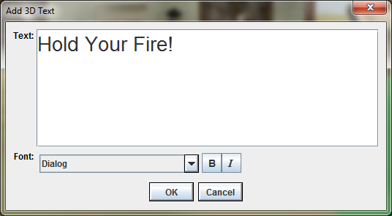
Step 1: Add the statusText to Your World
Set the camera’s point of view back to that of PlayerView.
Add a 3D Text object to your Alice world.
Type “Hold Your Fire!” for the text, and set the text font to “Dialog”
Rename the new 3D text object “statusText”.

Slide 3
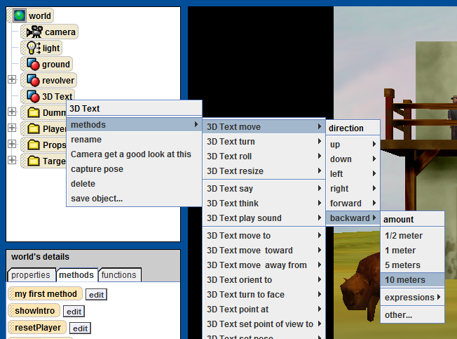
Step 2: Make the statusText Visible
It is likely that the statusText is behind the PlayerView. If this is the case, programmatically move the new text backwards 10 meters.

Slide 4
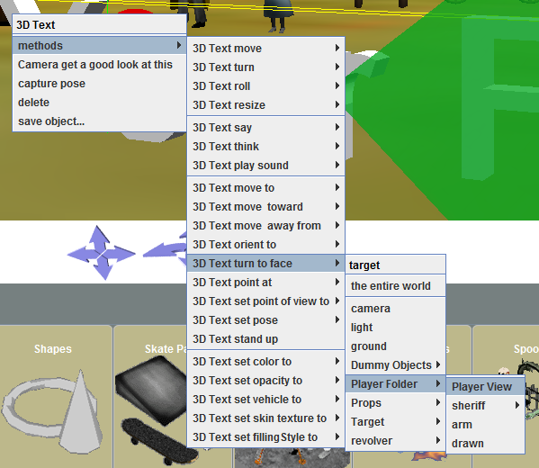
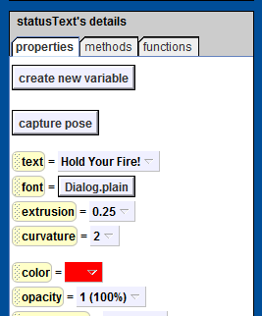

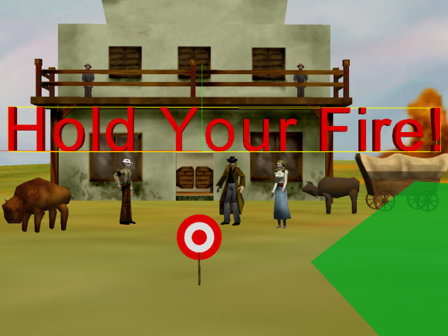
Step 3: Position the statusText
Once the statusText is visible, roughly center it in front of the player and the tell it to “turn to face PlayerView.” This will align the text with the Player View.
Resize and center the statusText in the PlayerView. Ideally, it will be as close to the PlayerView as possible while still being visible.
Change the statusText color to red.

Slide 5
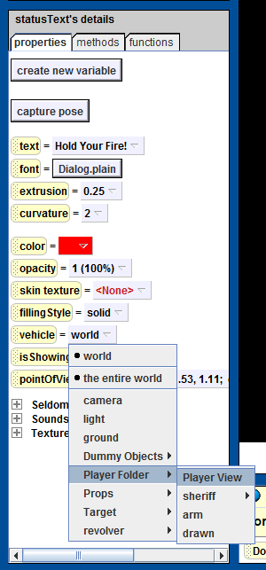
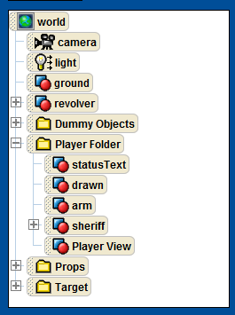
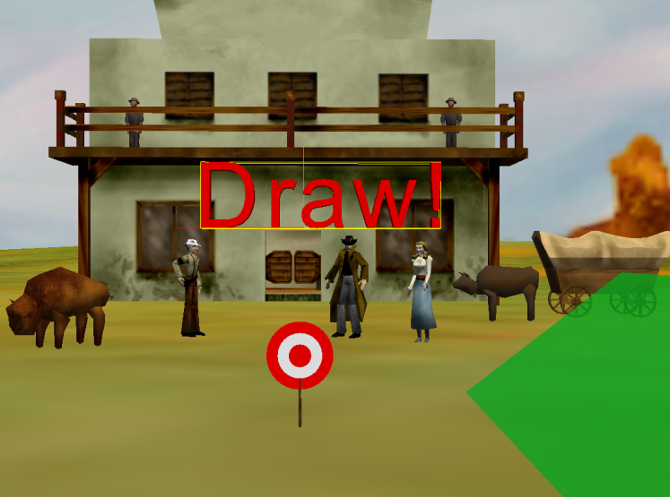
Step 4: Set the statusText Properties
Set the vehicle for the statusText to “PlayerView.”
Move the statusText object from the object tree into the “player” folder.
Change the text of the statusText to “Draw!”.

Slide 6
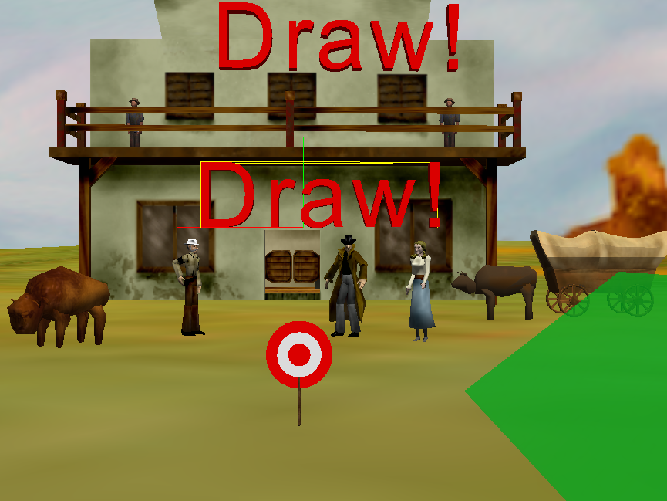
Step 5: Create the timerText
Repeat steps 1 through 4 for a new 3D text object named “timerText”.
If it makes it easier for you to manipulate the timerText, you can temperarily set the statusText’s “isShowing” property to “false.”
Also, you can use the copy button to reduce the amount of setup manipulation that you have to perform on the timerText.
Center the timerText at the top of the screen.

Slide 7
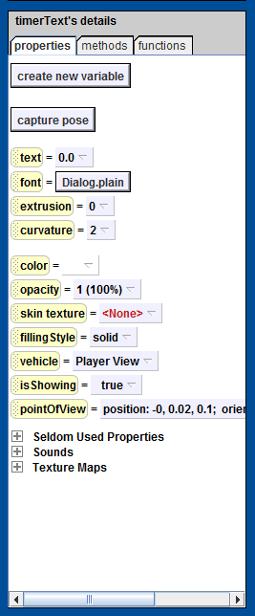
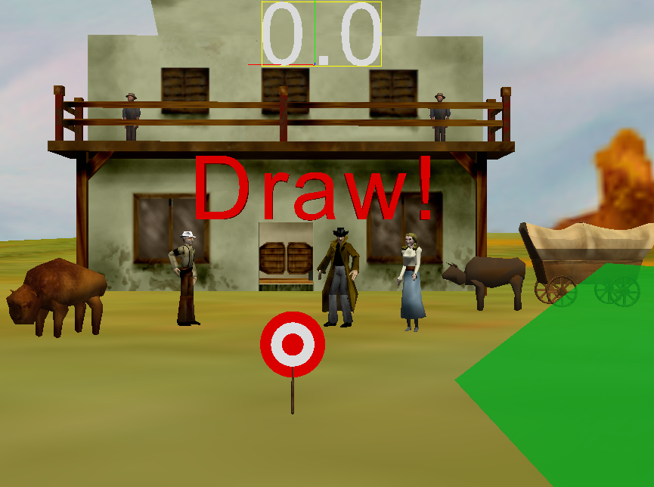
Step 6: Set the timerText Properties
Set the properties of the timerText to:
Text: “0.0”
Font: Dialog
Extrusion: 0.0
Color: no color
Vehicle: PlayerView

Slide 8
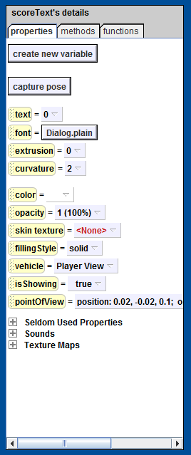
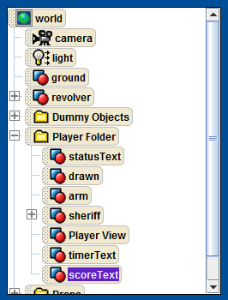
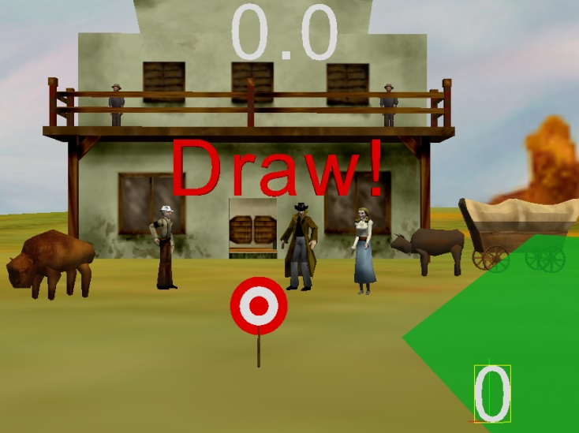
Step 7: Create the scoreText
Create a new 3D text object named “scoreText” as you did in steps 5 and 6.
Place the scoreText at the bottom, right corner of the screen.
Set the properties of the scoreText to:
Text: “0”
Font: Dialog
Extrusion: 0.0
Color: no color
Vehicle: PlayerView
Make sure that all of the new text objects are in the Player folder.

Slide 9
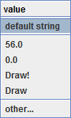
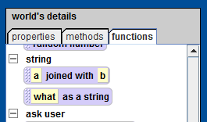
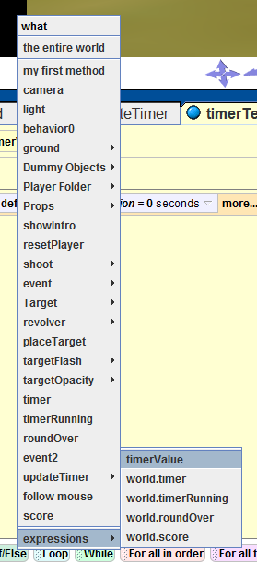
Step 8: Create the setTime Method
Create a new method for the timerText object called “setTime”.
Add a number parameter to the setTime method called “timerValue”.
Drag the text property for the timerText into the setTime method body and select “default string” from the pop-up menu.
From the world.functions tab, fine the “world.what as a string” function. Drag-and-drop the “world.what as a string” function over the “default string” value in the “set text to” line in the setTime function.
Set the input to timerValue

Slide 10
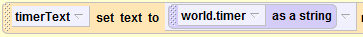
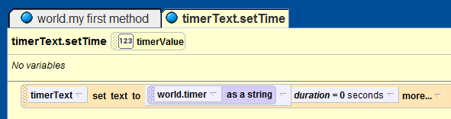
Step 9: Finish the setTime Method
Set the duration for the
line in the setTime function to 0.

Slide 11
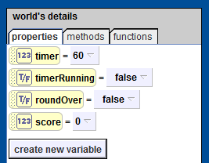
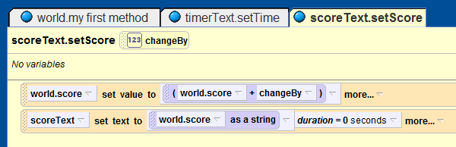
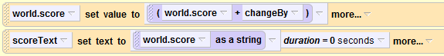
Step 10: Create the setScore Method
Create a new global, or world, number variable named “score”, and set its value to “0”.
Create a new method “setScore” for the scoreText object.
For the setScore function, create a new parameter named “changeBy” of type number.
Add the two lines
to the setScore function.

Slide 12
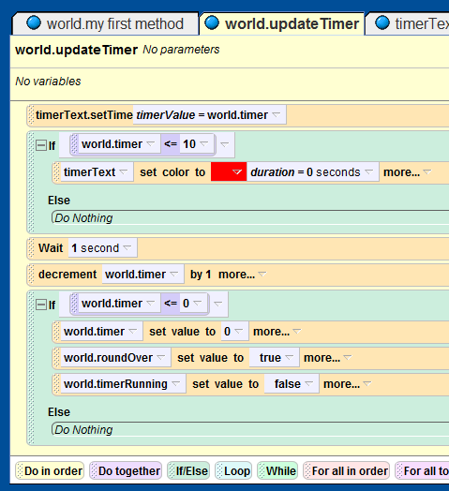
Step 11: Animate the Game Time
Add the line
To the top of the “world.updateTimer” method.
Add an if-statement to the world.updateTimer method just after the timerText line that you just added.
Drag the “world.timer” variable over the conditional for the new if-statement. From the pop-up menu, select “<=“ and then “10”.
Drag the “timerText.color” property into the top of the new if-statement and set the color to “red”.
Set the duration for the “timerText.color = red” line to “0”.

Slide 13
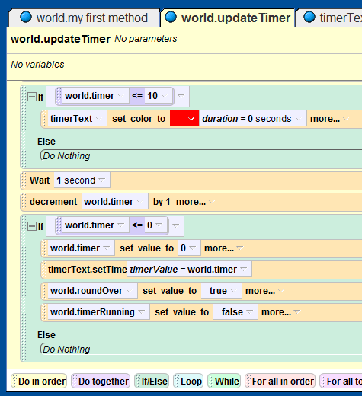
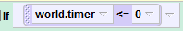
Step 12: Make Sure that the “0 – Time” Time Shows
Add the line
After the line
In the conditional that starts with
In the “world.updateTimer” function.

Slide 14
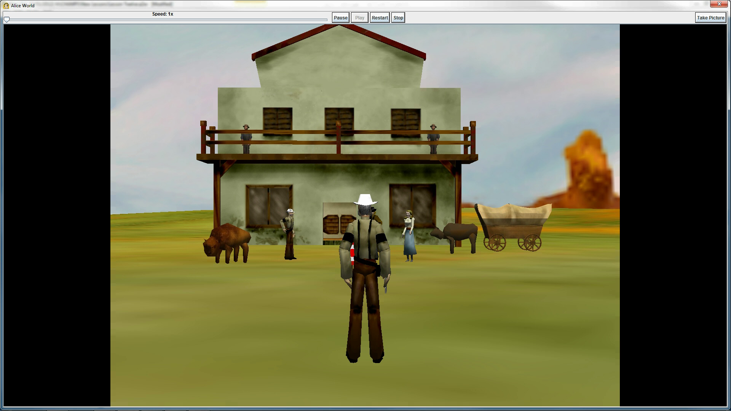
Final Scene

